Slide 1
Lung Disease Detection using neural networks, a comparative study of models.
FA23: APPLIED MACHINE LEARNING
Team Members:
Leonard Eckhoff
Mayur Jaisinghani
Kaushik Shridhar

Slide 2
Introduction
In the dynamic landscape of medical diagnostics, the battle against lung diseases intensifies, demanding innovative solutions. Our project focuses on harnessing the power of neural networks, specifically Convolutional Neural Networks (CNNs), Multilayer Perceptrons (MLP), and pretrained models like ResNet50 and DenseNet 121. Operating on a diverse dataset of high-resolution X-ray images capturing nuanced manifestations of lung diseases, our goal is to elevate predictive performance. Challenges abound, from the intricacies of human anatomy to the limited size of clinical samples and the inherent complexities in medical imaging. Through a comprehensive comparative analysis, we aim to propel the field forward, leveraging neural networks to navigate these challenges and enhance the accuracy of lung disease detection, a critical stride toward advancing medical diagnostics and ultimately improving patient outcomes.

Slide 3
Problem definition
This project addresses the challenge of developing neural network models for the effective detection and classification of lung diseases using high-resolution X-ray images, considering the scarcity of clinical samples, complexities in human anatomy, and inherent nuisances in medical imaging.

Slide 4
Justification for the proposed problem
Motivation and Need
Current lung disease detection methods, akin to blacklisting in cybersecurity, may not adequately cover the diverse manifestations of ailments, limiting their effectiveness. While existing classifiers achieve around 90% accuracy, the intricate nature of human anatomy and challenges in medical imaging necessitate a more sophisticated approach. This project employs multiple neural network models with Ensemble Learning to enhance accuracy and performance in classifying various lung diseases based on high-resolution images.

Slide 5
Research Gap
Limited Exploration of Model Applications:
Further exploration needed on how ResNet50 and VGG16 have been applied in similar medical projects for pneumonia detection.
Documentation Gap in Model Integration:
Research gap in detailing the integration process of ResNet50 and VGG16 into the medical image diagnostic pipeline, especially focusing on pneumonia.
Insufficient Exploration of Validation Techniques:
Lack of specificity in exploring and comparing different validation techniques, such as K-fold cross-validation, and their impact on accuracy.

Slide 6
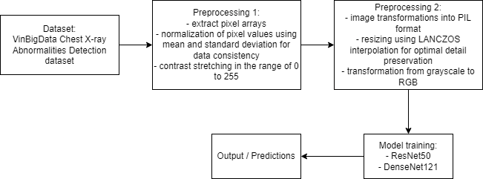
System Architecture

Slide 7
Data Set
Source of data set:
Dataset of Chest X-Ray abnormalities
Dataset https://www.kaggle.com/c/vinbigdata-chest-xray-abnormalities-detection/data
This dataset consists of all the features of various classes of lung diseases.

Slide 8
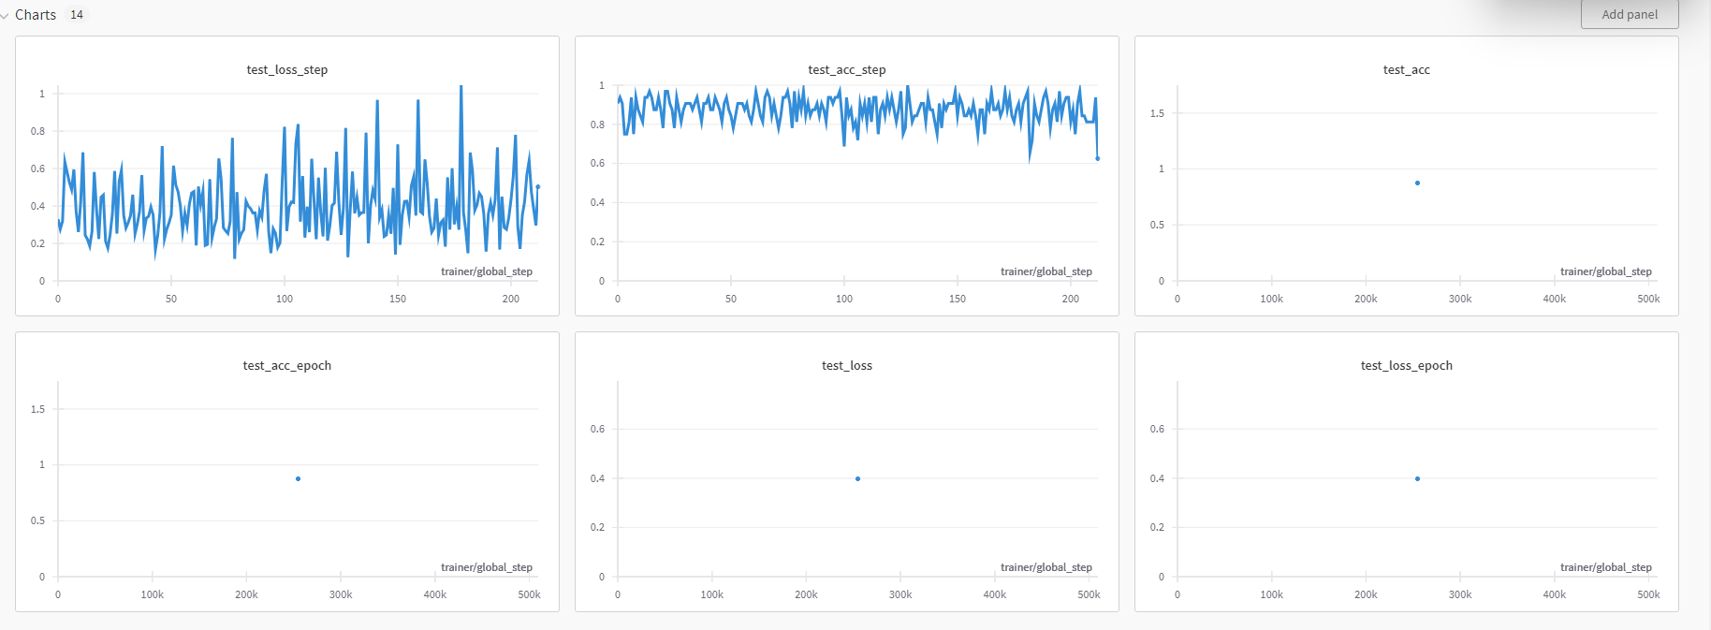
Results
ResNet50 all rad_id

Slide 9
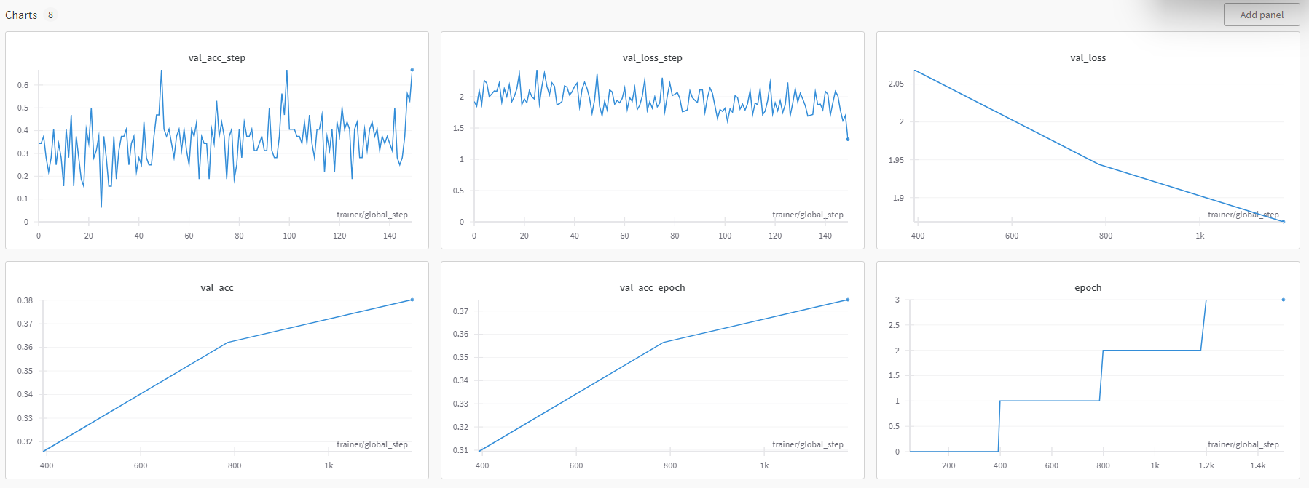
DenseNet121 R9

Slide 10
Conclusion
This study compares the efficacy of convolutional neural networks (CNNs), multilayer perceptrons (MLPs), and pretrained models (ResNet50, DenseNet121) in detecting lung diseases from X-ray images. The research emphasizes diverse dataset characteristics and medical conditions to assess model performance. The findings offer valuable insights into optimal neural network choices for accurate lung disease classification.

Slide 11
References
D.G. Peroni, A.L. Boner, Atelectasis: mechanisms, diagnosis and management, Paediatric Respiratory Reviews, Volume 1, Issue 3, 2000, Pages 274-278, ISSN 1526-0542, https://doi.org/10.1053/prrv.2000.0059.
Jones J, Weerakkody Y, Worsley C, et al. Atelectasis (summary). Reference article, Radiopaedia.org (Accessed on 10 Dec 2023) https://doi.org/10.53347/rID-51373
Giachelli, Cecilia M.. Vascular Calcification Mechanisms. Journal of the American Society of Nephrology 15(12):p 2959-2964, December 2004. | DOI: 10.1097/01.ASN.0000145894.57533.C4
Weerakkody Y, Niknejad M, Bell D, et al. Pulmonary calcification. Reference article, Radiopaedia.org (Accessed on 10 Dec 2023) https://doi.org/10.53347/rID-52343
Amin H, Siddiqui WJ. Cardiomegaly. [Updated 2022 Nov 20]. In: StatPearls [Internet]. Treasure Island (FL): StatPearls Publishing; 2023 Jan-. Available from: https://www.ncbi.nlm.nih.gov/books/NBK542296/

Slide 12
THANK YOU

